Slide 1
Chirp rate for RCBG

Slide 2
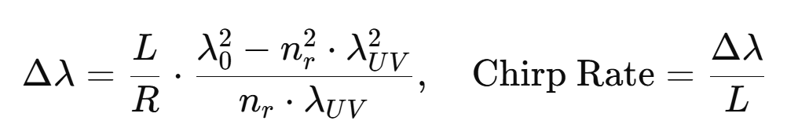
Bandwidth calculation

Slide 3
Different lenses
Focal Length (mm) | Radius R (mm) | Bandwidth (nm) | Chirp Rate (nm/mm)
3000 | 6000 | 6.504662 | 0.260186
2000 | 4000 | 9.756993 | 0.39028
1500 | 3000 | 13.00932 | 0.520373
1000 | 2000 | 19.51399 | 0.780559
750 | 1500 | 26.01865 | 1.040746
500 | 1000 | 39.02797 | 1.561119
250 | 500 | 78.05595 | 3.122238
100 | 200 | 195.1399 | 7.805595
50 | 100 | 390.2797 | 15.61119
25 | 50 | 780.5595 | 31.22238

Slide 4
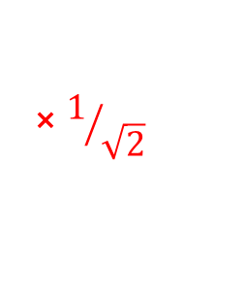

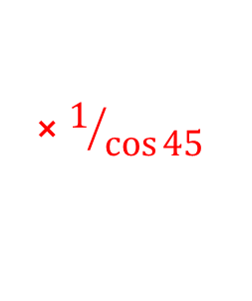
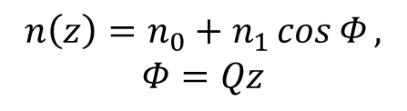

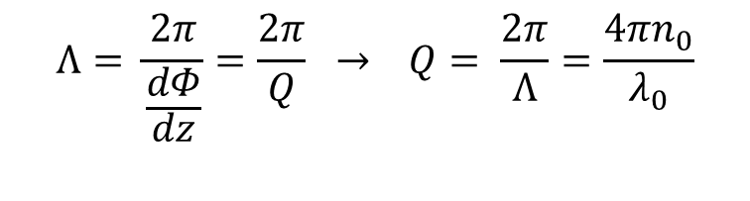
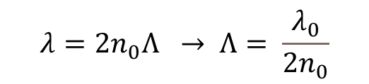
How get this equation
RBG equation
$$θ=45$$
$$λ=2n_{0}Λ\cos{θ} , θ=0,$$
$$λ=2n_{0}Λ → Λ= \frac{λ_{0}}{2n_{0}}$$
$$⨯1/{\cos{45}}$$
$$n\left(z\right)=n_{0}+n_{1}\cos{Φ},$$
$$Φ=Qz$$
$$Λ= \frac{2π}{\frac{dΦ}{dz}}=\frac{2π}{Q} → Q= \frac{2π}{Λ}=\frac{4πn_{0}}{λ_{0}}$$
$$⨯1/{\sqrt{2}}$$

Slide 5

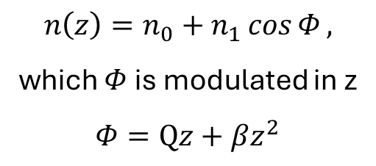
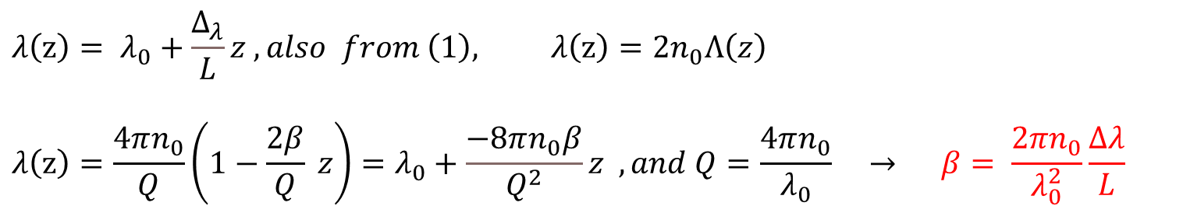
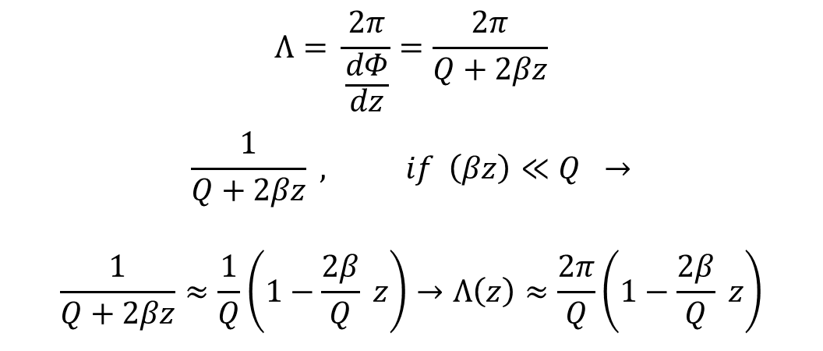




Chirped RBG equation
$$λ(z)=2n_{0}Λ(z)\cos{θ} , θ=0,$$
$$θ=45$$
$$λ\left(z\right)=2n_{0}Λ\left(z\right)$$
$$\left(1\right)$$
$$Λ= \frac{2π}{\frac{dΦ}{dz}}=\frac{2π}{Q+2βz}$$
$$\frac{1}{Q+2βz} , if \left(βz\right)≪Q →$$
$$\frac{1}{Q+2βz}≈\frac{1}{Q}\left(1−\frac{2β}{Q} z\right)→Λ\left(z\right)≈\frac{2π}{Q}\left(1−\frac{2β}{Q} z\right)$$
$$n\left(z\right)=n_{0}+n_{1}\cos{Φ},$$
which $Φ$ is modulated in z
$$Φ=Qz+βz^{2}$$
$$(2)$$
$$λ\left(z\right)= λ_{0}+\frac{Δ_{λ}}{L}z , also from \left(1\right), λ\left(z\right)=2n_{0}Λ\left(z\right)$$
$$λ\left(z\right)=\frac{4πn_{0}}{Q}\left(1−\frac{2β}{Q} z\right)=λ_{0}+\frac{−8πn_{0}β}{Q^{2}}z , and Q=\frac{4πn_{0}}{λ_{0}} → β= \frac{2{πn}_{0}}{λ_{0}^{2}}\frac{Δλ}{L}$$
On the other hand,

Slide 6
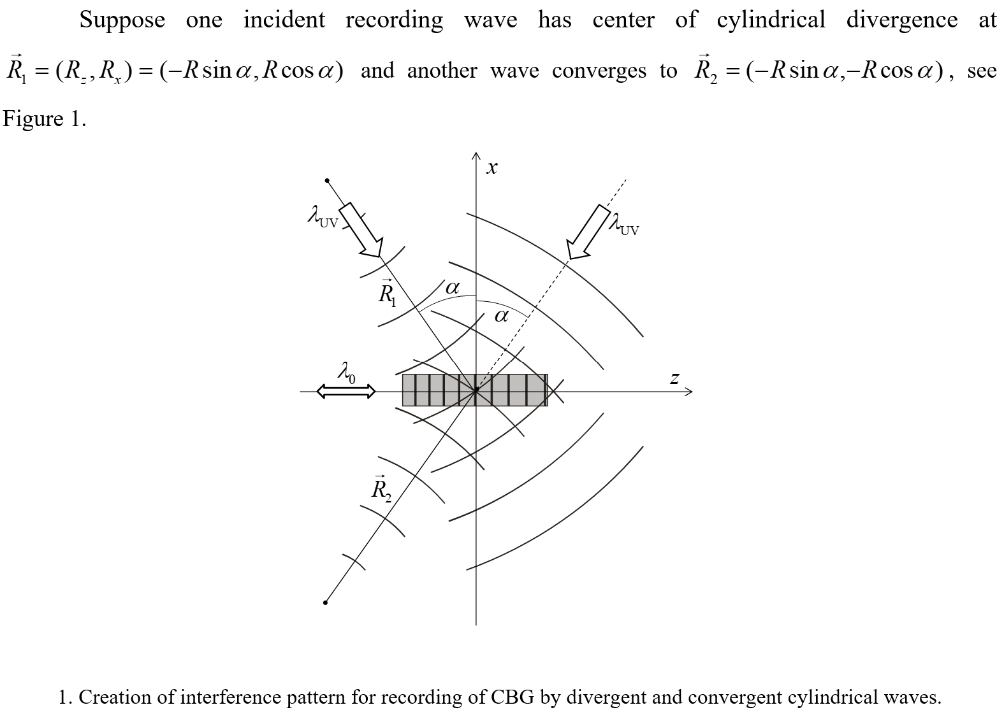
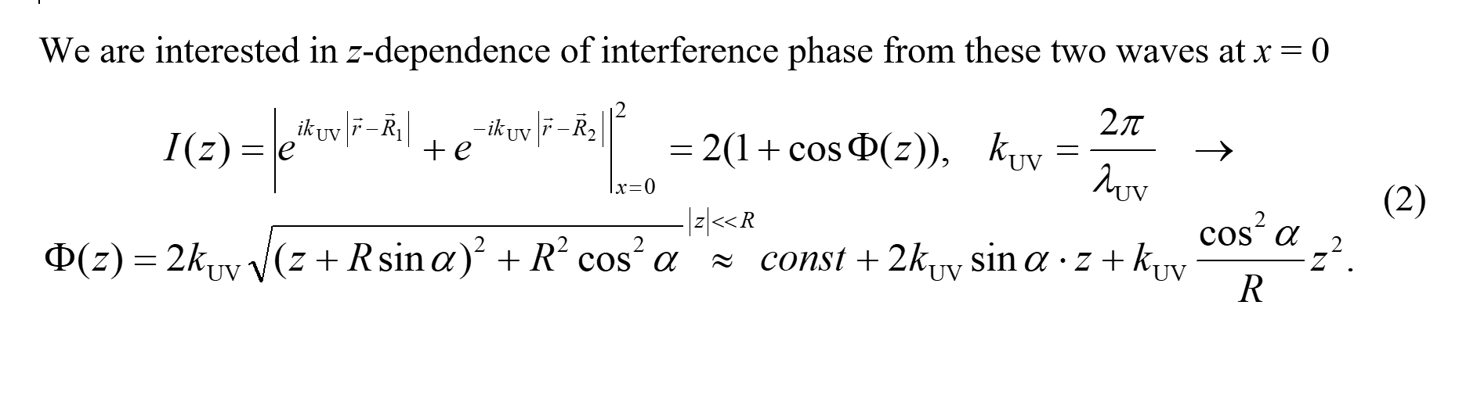
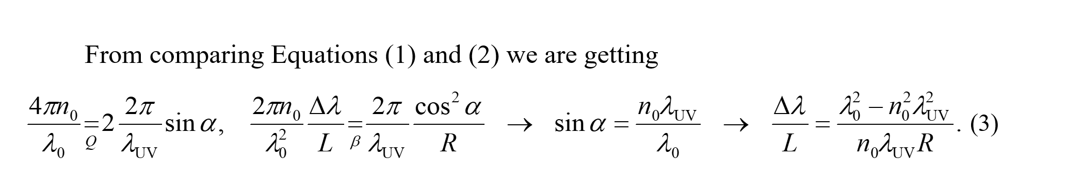

Slide 7

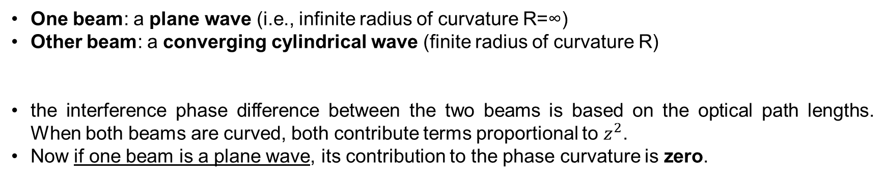

One plane wave and spherical waves for recording
One beam: a plane wave (i.e., infinite radius of curvature R=∞)
Other beam: a converging cylindrical wave (finite radius of curvature R)
the interference phase difference between the two beams is based on the optical path lengths. When both beams are curved, both contribute terms proportional to $z^{2}$.
Now if one beam is a plane wave, its contribution to the phase curvature is zero.
$$φ\left(z\right)=φ_{1}−φ_{2}$$
$$φ_{2}\left(z\right)= \vec{k} \sqrt{x^{2}+{\left(R−z\right)}^{2}}≈ K\left[R−z\sin{α}+\frac{z^{2}}{2R}\cos{α}\right]\left(X=0,z<<R\right)$$
$φ_{1}\left(z\right)$ = $K z\sin{α}$
So, the chirp rate would be half of the previous one.

Slide 8

Example of recording
lambda_0= (580*1.41)= 817.8; %in nm
UV=325;%nm
L=25; %mm
f=180;%mm
Spectral bandwidth Δλ = 48.7247 nm
Chirp rate = 1.9490 nm/mm

Slide 9
Example of recording
lambda_0= (1064*1.41); %in nm
UV=325;%nm
L=25; %mm
f=3000 (2*1500);%mm
Spectral bandwidth Δλ = 15.1513 nm
Chirp rate = 0.6061 nm/mm

Slide 10
Recording considerations
Align the glass sample and find the zero-fringe after or before rotating glass 45 degrees.
Which glass is better? Does scattering related to the glass or setup?
Remove the piezo stage.

